Slide 1
Introduction to Markov models for cost-effectiveness analysis
14 February 2024

Slide 2
Disclosures and Disclaimers
The author has no relevant financial or nonfinancial relationships to disclose.
During the development, analysis, and preparation of this presentation, the author was an employee of the Veterans Health Administration, U.S. Department of Veterans Affairs.
The views and opinions expressed in this presentation are those of the author and do not necessarily reflect the official policy or position of any agency of the U.S. government.

Slide 3
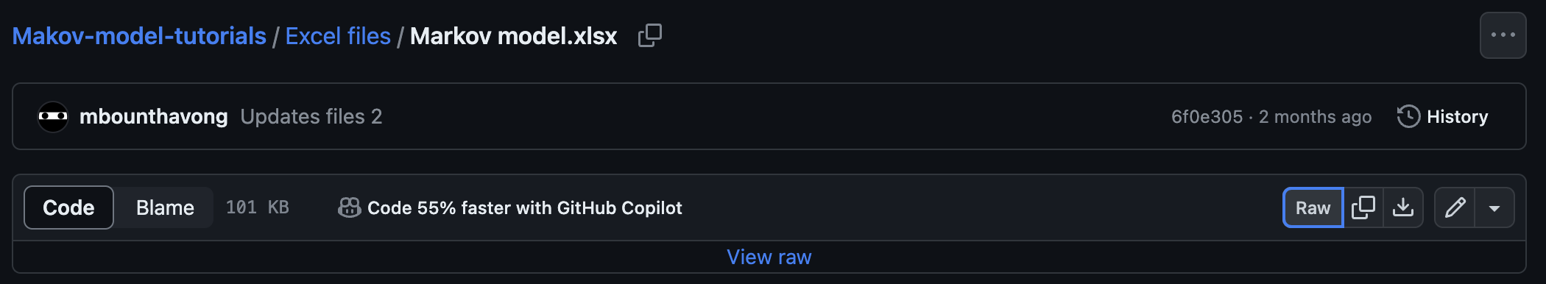
Download files from github
Right-click and save link as on your computer
Link to GitHub page

Slide 4
Outline
Limitations of decision trees
Markov model description
Markov model features
Markov chain versus process
Discounting and Inflation

Slide 5
Limitations of decision tree (1)
Chronic diseases have long time horizons
Can’t possibly capture all the re-entry points in a decision tree (becomes repetitive)
Markov re-entry nodes are convenient; decision branches are messy
Markov models are good alternatives to decision trees

Slide 6
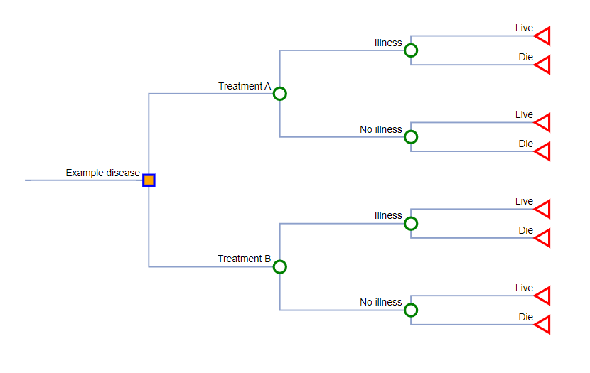
Limitations of decision tree (2)

Slide 7
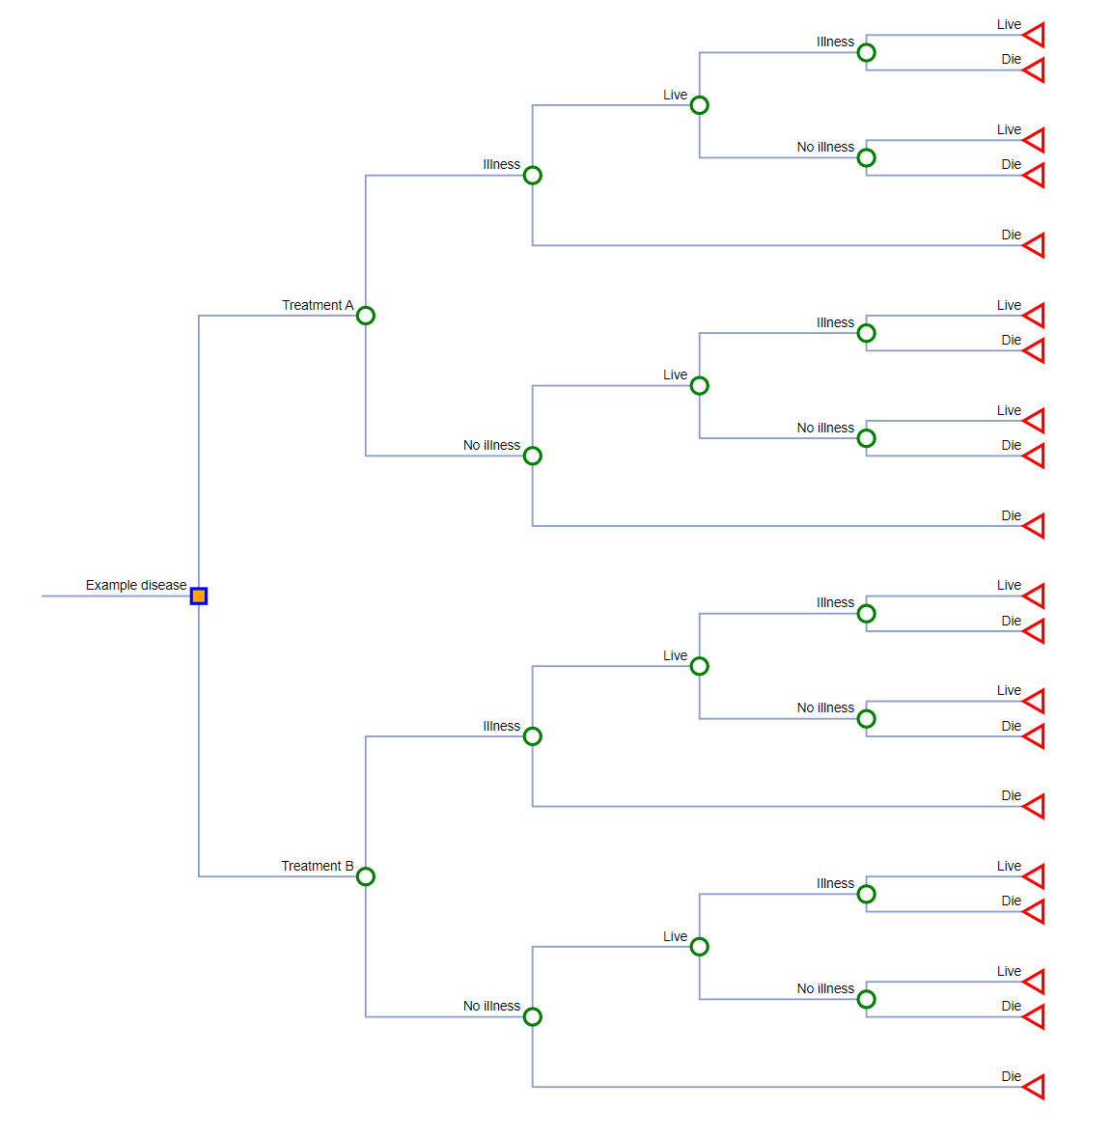
Limitations of decision tree (3)
This part of the decision tree is a repeat of the Illness node.
When a subject has an illness, they can live or die. If they live and have another illness, they can live or die once again.
This cycle repeats itself over and over.

Slide 8
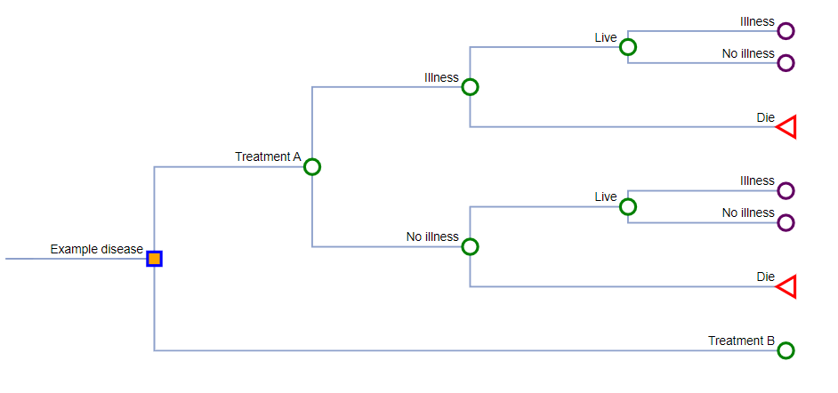
Limitations of decision tree (4)

Slide 9
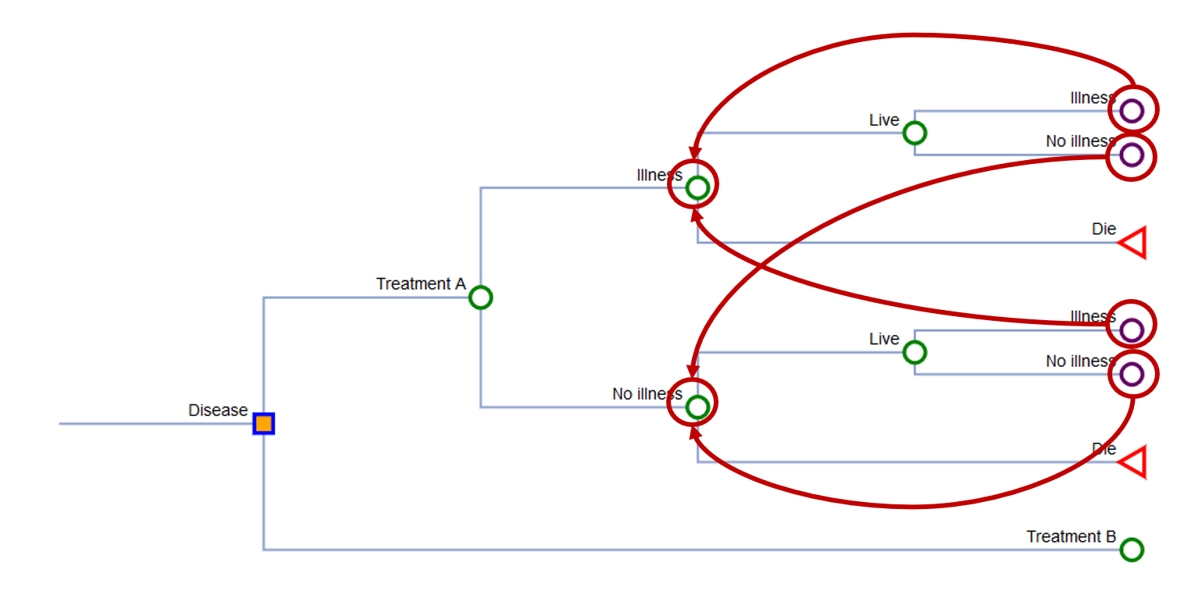
Limitations of decision tree (5)
Well → Well
Well → Illness
Well → Death
Illness → Illness
Illness → Well
Illness → Death
Death → Death

Slide 10
Markov model structure
Well
Illness
Dead
Costs
Benefits
Assigned to the states

Slide 11
Markov model - description
Markov models are state-transition models
Useful when modeling chronic diseases
Each state represents a disease stage (or process)
Costs and benefits are assigned to each state
Can apply discounting
Individual subject can only be in one state at any cycle

Slide 12
Markov model – disease states
Well
Illness
Dead
Asymptomatic state
Disease state
Absorbing state

Slide 13
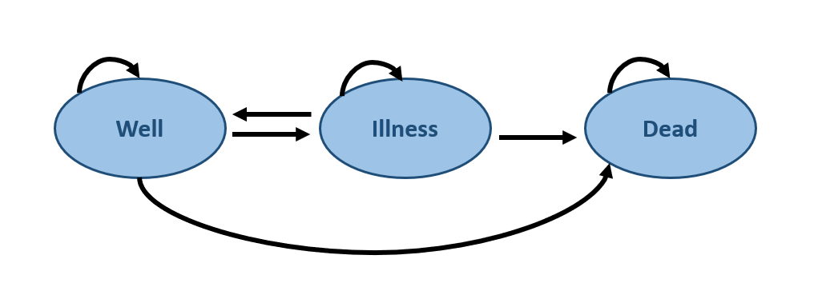
Markov model – transition probabilities (1)
Well → Well
Well → Illness
Well → Death
Illness → Illness
Illness → Well
Illness → Death
Death → Death
tp1
tp2
tp3
tp4
tp5
tp6
tp7
100%
tp1
tp4
tp7
tp5
tp6
tp2
100%
tp3

Slide 14
Markov model – transition probabilities (2)
If you have tp2 and tp3, then tp1 = 1 – tp2 – tp3
Well → Well
Well → Illness
Well → Death
Illness → Illness
Illness → Well
Illness → Death
Death → Death
tp1
tp2
tp3
tp4
tp5
tp6
tp7
100%
tp1
tp4
tp7
tp5
tp6
tp2
100%
tp3

Slide 15
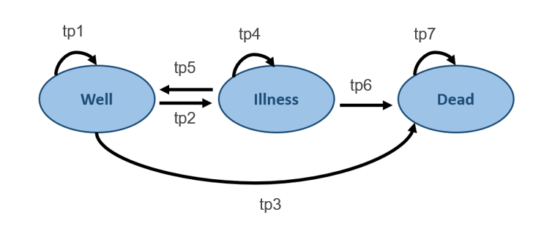
Markov matrix
From / To | Well | Illness | Dead
Well | tp1 (1 – tp2 – tp3) | tp2 | tp3
Illness | tp5 | tp4 (1 – tp5 – tp6) | tp6
Dead | 0 | 0 | tp7

Slide 16
Markov model – features
One iteration = Cycle
X-iterations = Time horizon
1 cycle
Time horizon

Slide 17
Markov chain versus process (1)
Markov chain – static transitions
Markov process – dynamic transitions
tp1
tp4
tp7
tp5
tp6
tp2
tp3

Slide 18
Markov chain versus process (2)
Markov chain – static transitions
Markov process – dynamic transitions
Transition probabilities remain static
If tp1 = 0.90 is cycle 1, then tp1 = 0.90 in cycle 2
tp1
tp4
tp7
tp5
tp6
tp2
tp3

Slide 19
Markov chain versus process (3)
Markov chain – static transitions
Markov process – dynamic transitions
Transition probabilities change from cycle to cycle
Although tp1 = 0.90 is cycle 1, tp1 = 0.85 in cycle 2
tp1
tp4
tp7
tp5
tp6
tp2
tp3

Slide 20
Markov chain versus process (4)
Markov chain – static transitions
Markov process – dynamic transitions
This is useful when the cohort will have a lower survival over a long period of time
tp1
tp4
tp7
tp5
tp6
tp2
tp3

Slide 21
Cohort versus Microsimulations (1)
Cohort simulation
Model a group of hypothetical patients at the same time
Time horizon is fixed
Computationally less intensive
Individual or microsimulations (Monte Carlo)
Individuals are modeled through the Markov models one at a time
Time for each patient can be short or long
Computationally intensive

Slide 22
Cohort versus Microsimulations (1)
Cohort simulation
Individual or microsimulations
Well
Illness
Dead
Initial
Well
Illness
Dead
Cycle 1
Well
Illness
Dead
Cycle 2

Slide 23

Cohort versus Microsimulations (2)
Cohort simulation
Individual or microsimulations
Well
Illness
Dead
Initial
Well
Illness
Dead
Cycle 1
Well
Illness
Dead
Cycle 2

Slide 24
Cohort versus Microsimulations (3)
Cohort simulation
Individual or microsimulations
Well
Illness
Dead
Initial
Well
Illness
Dead
Cycle 1
Well
Illness
Dead
Cycle 2

Slide 25
Cohort versus Microsimulations (4)
Cohort simulation
Individual or microsimulations
Well
Illness
Dead
Initial
Well
Illness
Dead
Cycle 1
Well
Illness
Dead
Cycle 2

Slide 26
Cohort versus Microsimulations (5)
Cohort simulation
Individual or microsimulations
Well
Illness
Dead
Initial
Well
Illness
Dead
“Memoryless”
(Markovian Assumption)
Cycle 1
Well
Illness
Dead
Cycle 2

Slide 27
Cohort versus Microsimulations (6)
Tunnel states are used to force the model to consider the previous state
Cohort simulation
Individual or microsimulations
Well
Illness
Dead
Initial
Well
Illness
Dead
“Memoryless”
(Markovian Assumption)
Cycle 1
Well
Illness
Dead
Cycle 2

Slide 28
Cohort versus Microsimulations (7)
Cohort simulation
Individual or microsimulations
Well
Illness
Dead
“First order” Montel Carlo
Generate variance around the cost and benefits
Initial
Well
Illness
Dead
Cycle 1
Well
Illness
Dead
Cycle 2

Slide 29
Cohort versus Microsimulations (8)
Cohort simulation
Individual or microsimulations
Well
Illness
Dead
Initial
Well
Illness
Dead
Cycle 1
Well
Illness
Dead
Cycle 2

Slide 30
Cohort versus Microsimulations (9)
Cohort simulation
Individual or microsimulations
Well
Illness
Dead
Initial
Well
Illness
Dead
Cycle 1
Well
Illness
Dead
Cycle 2

Slide 31
Cohort versus Microsimulations (10)
Cohort simulation
Individual or microsimulations
Well
Illness
Dead
Initial
Well
Illness
Dead
Cycle 1
Well
Illness
Dead
Cycle 2

Slide 32
Cohort versus Microsimulations (11)
Cohort simulation
Individual or microsimulations
Well
Illness
Dead
Initial
Well
Illness
Dead
Cycle 1
Well
Illness
Dead
Cycle 2

Slide 33
Cohort versus Microsimulations (12)
Cohort simulation
Individual or microsimulations
Well
Illness
Dead
Initial
Well
Illness
Dead
Cycle 1
Well
Illness
Dead
Cycle 2

Slide 34
Estimating transition probabilities
Using existing studies to estimate probabilities for decision models

Slide 35
Estimating transition probabilities (1)
Rate – Instantaneous likelihood of transition at any point in time (e.g., 5 events per 100 Person Years)
Probability – Proportion of a cohort that experiences the event over a specific period (e.g., 90% of patients had the event)
To get the transition probabilities in a Markov model using an existing study, estimate the rate, then estimate the probability for the time of interest using the rate

Slide 36


Estimating transition probabilities (2)
Estimating the probability from a study:
Probability from study → Rate → Probability for model
$$Rate= \frac{−ln⁡(1−p)}{t}$$
$$Probability=1−e^{−rt}$$
p probability
t time
r rate

Slide 37



Estimating transition probabilities (3)
If the 5-year probability of achieving a cure is 90%, what is the 1-year probability?
You can’t divide the 5-year probability by 5 (e.g., 90% / 5 = 18% to get the annual rate)
Probability from study
$$Rate= \frac{−ln⁡(1−p)}{t}$$
$$P(t)=1−e^{−rt}$$
P(5 years) = 90%
$$Rate= \frac{−ln⁡(1−0.90)}{5 years}=0.46$$
$$P\left(1 year\right)=1−e^{−\left(0.46\right)\left(1 year\right)}=0.37$$

Slide 38
Estimating transition probabilities (4)
Correct probability
0.90 @ 5 years
$$P\left(1 year\right)=1−e^{−\left(0.46\right)\left(1 year\right)}=0.37$$
Incorrect probability
$$P\left(1 year\right)=1−e^{−\left(0.18\right)\left(1 year\right)}=0.16$$

Slide 39

Estimating transition probabilities (5)
Suppose you had data from a meta-analysis where the relative risk of cure is 2.0 with a drug
What is the 1-year probability of cure using an annual rate of cure that is 0.47? (Hint: Is it not 2 x 0.47)
RR * rate
$$P(t)=1−e^{−rt}$$
2.0 X 0.47 = 0.94
$$P\left(1 year\right)=1−e^{−\left(0.94\right)\left(1 year\right)}=0.61$$

Slide 40
Discounting and inflation
Adjusting costs and outcomes for long time horizons

Slide 41
Discounting and inflation
Net Present Value: Current purchasing power of currency
Inflation
Discounting
NPV
tp
t0
tf

Slide 42


Discounting
What is today’s value of $1 10 years from now using a 3% discount rate?
$$V_{0}=\frac{V_{t}}{{\left(1+r\right)}^{t}}$$
$$\$0.74=\frac{\$1}{{\left(1+0.03\right)}^{10}}$$
V0 = Value in today’s term
Vt = Value at time t in the future
r = Discount rate
t = Time in the future

Slide 43
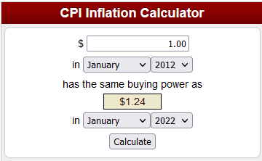
Inflation
What is today’s value of $1 from 10 years ago using the Consumer Price Index?
Use the CPI inflation calculator on the BLS website

Slide 44
Markov models using Excel
Tutorial on building Markov models in Excel

Slide 45
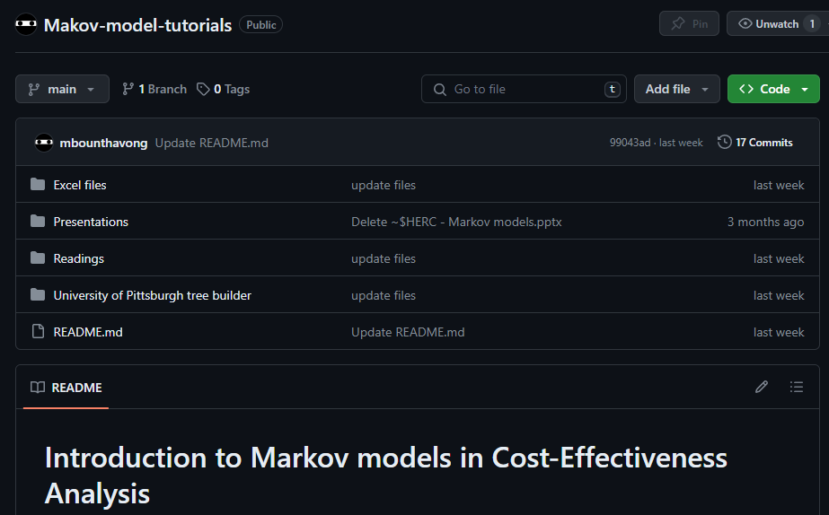
File location
You can download the Excel file from the workshop’s GitHub site

Slide 46
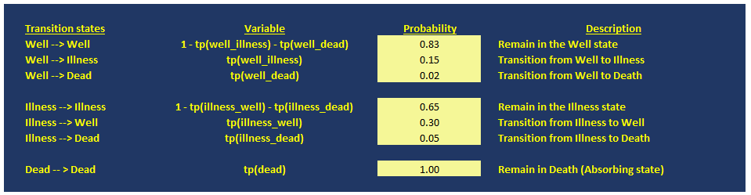
Setting up the Markov model
List all the transitions

Slide 47
Markov matrix
From / To | Well | Illness | Dead
Well | 0.83 | 0.15 | 0.02
Illness | 0.30 | 0.65 | 0.05
Dead | 0 | 0 | 1.00

Slide 48
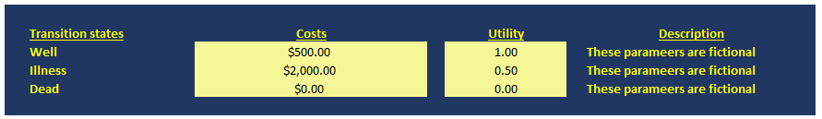
Assign costs and utilities to the states
Since the costs and utilities are specific to each state you can list them in a table

Slide 49
Model properties
Each cycle is 1 year
Simulate for 100 years (or 100 cycles)
Apply an annual discount rate of 3% on costs and outcomes

Slide 50
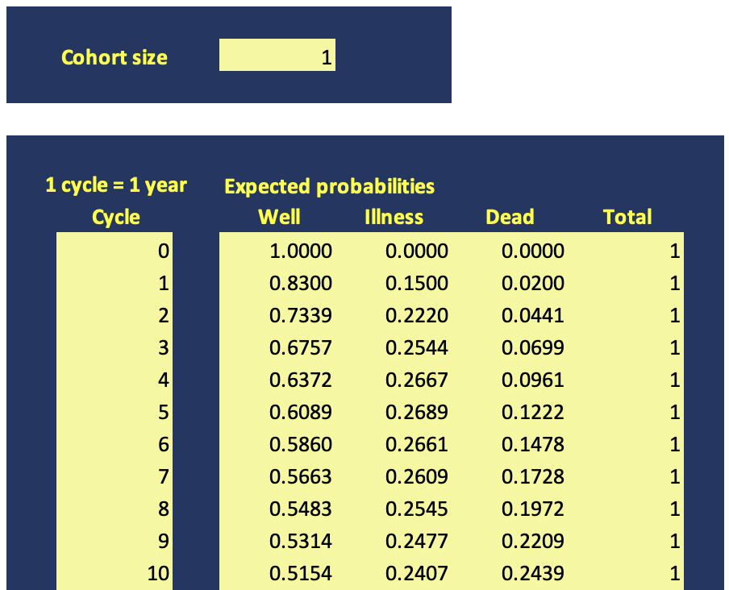
Mathematical model
We start at cell E12

Slide 51
Mathematical model
The size of the cohort. We’ll set this at 1.
The cell is G6.
At cycle 0, all subjects will start at the “Well” state.
In the cell, the formula is:
=$G$6 * 1
The “$” denotes that the column / row does not change.
At cycle 0, zero subjects will start at the “Illness” and “Dead” states.
In these cells, the formulas are:
=$G$6 * 0
Based on probability theory the sum of the expected number of subjects should be equal to cell G6. In this case, that will be 1.

Slide 52
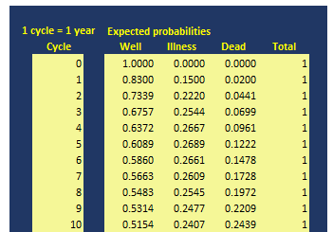
Calculating expected probabilities (1)
1 - tp(well_illness) - tp(well_dead)
tp(well_illness)
tp(well_dead)

Slide 53
Limitations of decision trees (2)
tp7
Well
Illness
Dead
tp6
tp3

Slide 54
Calculating expected probabilities (1)
1 - tp(well_illness) - tp(well_dead)

Slide 55
Calculating expected probabilities (2)
tp(well_illness)

Slide 56
Calculating expected probabilities (3)
tp(well_dead)

Slide 57
Calculating expected probabilities (4)
Check to see that the probabilities sum to 1

Slide 58
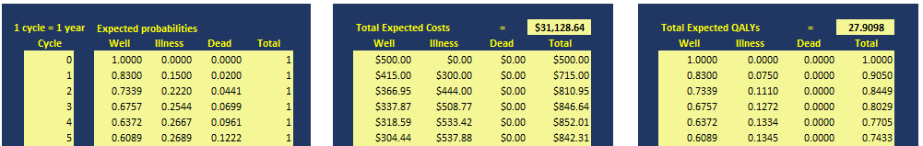
Calculating expected costs and utilities (1)
Expected costs at cycle 1 is 0.83 * $500 = $415

Slide 59
Calculating expected costs and utilities (2)
Expected costs at cycle 2 is 0.7339 * $500 = $366.95

Slide 60
Calculating expected costs and utilities (3)
Expected utility at cycle 1 is 0.83 * 1 = 0.83 QALYs

Slide 61
Calculating expected costs and utilities (4)
Expected utility at cycle 2 is 0.7339 * 1 = 0.73 QALYs

Slide 62
Calculating expected costs and utilities (5)
Sum the costs to get the total expected costs
Sum the QALYs to get the total expected QALYs

Slide 63
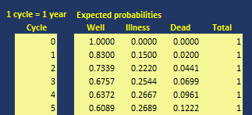
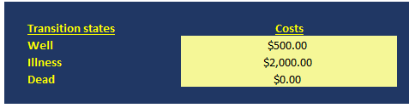
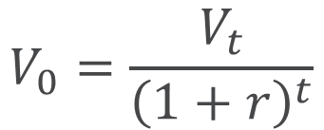
Applying discounting
$$V_{0}=\frac{V_{t}}{{\left(1+r\right)}^{t}}$$
r is the annual discount rate at 3%

Slide 64
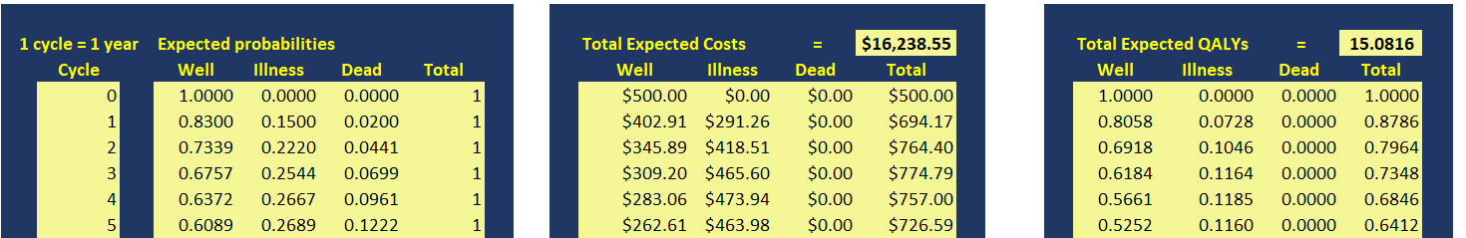
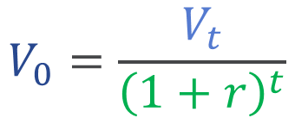
Discount expected costs and utilities (1)
Expected costs at cycle 1 with discounting is
$402.91 = (0.83 * $500) / (1 + 0.03)¹
$$V_{0}=\frac{V_{t}}{{\left(1+r\right)}^{t}}$$

Slide 65

Markov model results (1)

Slide 66
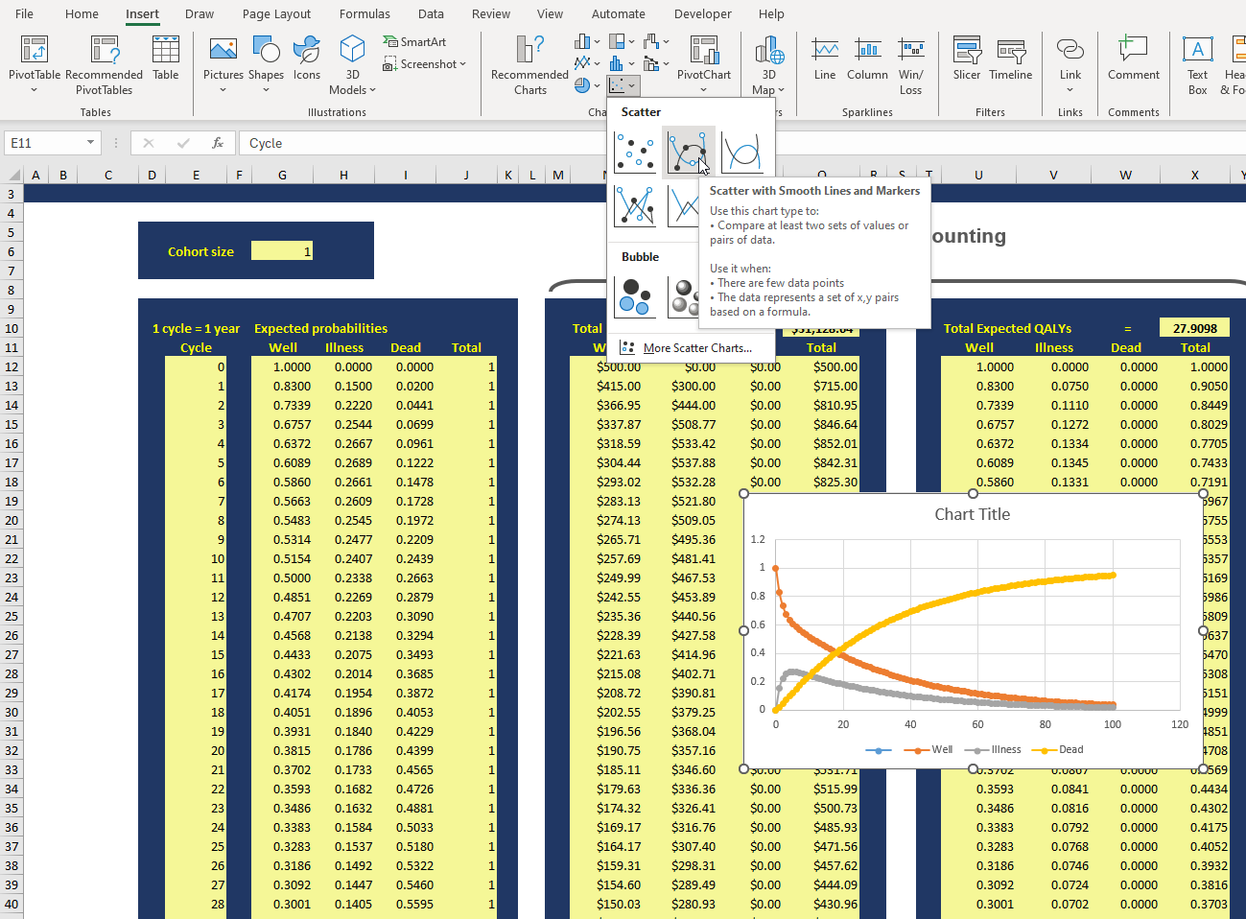
Markov model results (2)
Step 2: Insert a chart using the X-Y scatter and the Scatter with Smooth Lines and Markers
Step 1: Select the data from cycle 0 to 100
Step 3: A chart will appear; make changes to match the figure

Slide 67
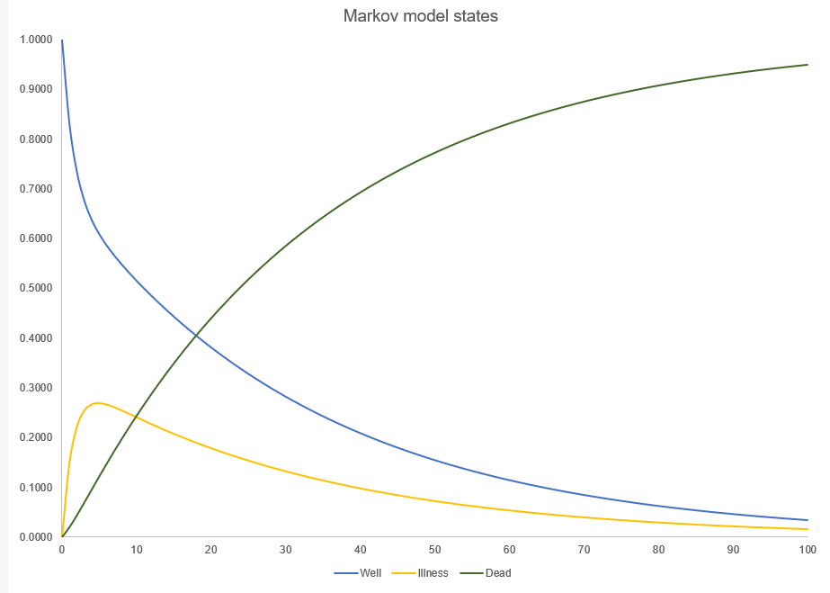
Markov model results (2)

Slide 68


Questions
email: mark.bounthavong@va.gov
GitHub: https://github.com/mbounthavong

Slide 69

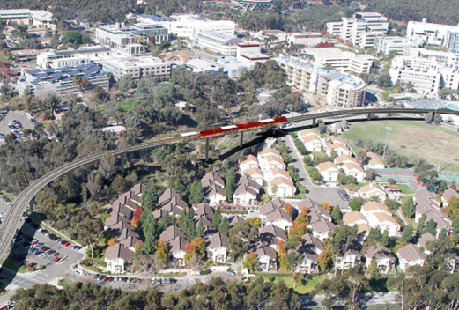
REFERENCES
Briggs and Sculpher - Introduction to Markov Models
GitHub site for Markov model
Online Markov model tutorial (link)

